Slide 1

welcome

Slide 2
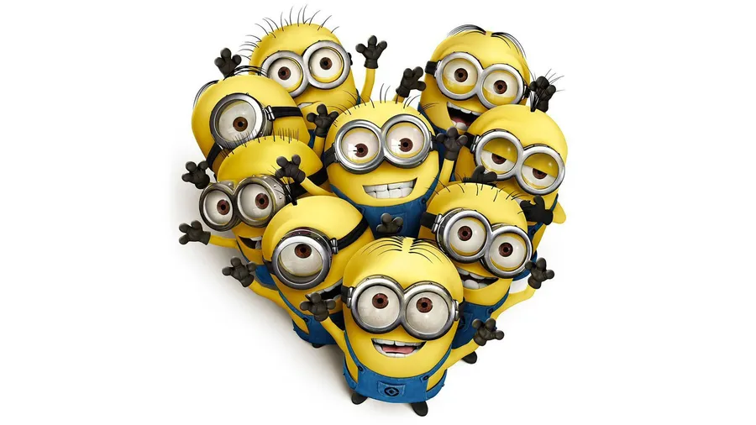
PROJECT NAME: TOON TRANSLATER
Guided by : Supriya Indore

Slide 3
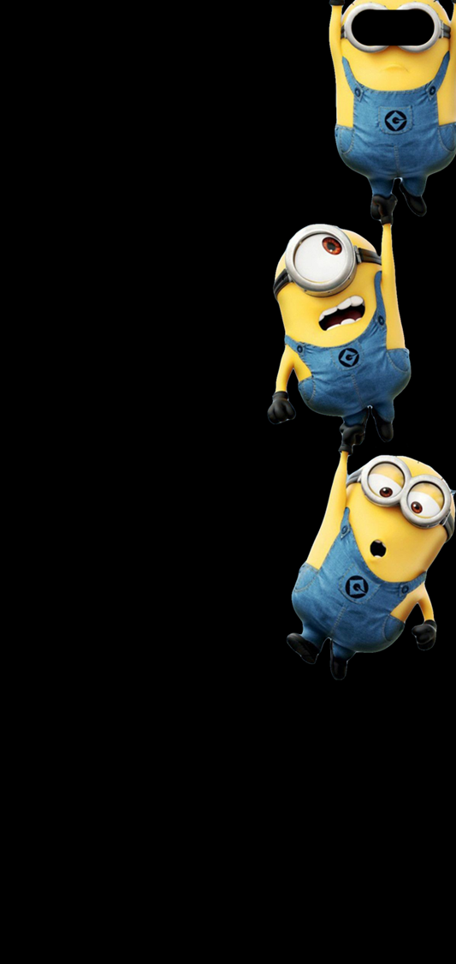
INTRODUCTION
What are significance of cartoon?
Cartoons are used today primarily for conveying political commentary and editorial opinion in newspapers and for social comedy and visual wit in magazines

Slide 4
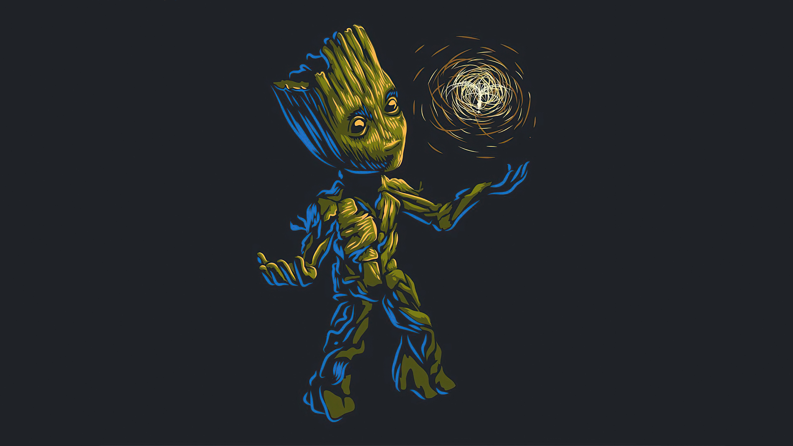
Translator
Language translators allow computer programmers to write sets of instructions in specific programming languages. These instructions are converted by the language translator into machine code. The computer system then reads these machine code instructions and executes them

Slide 5
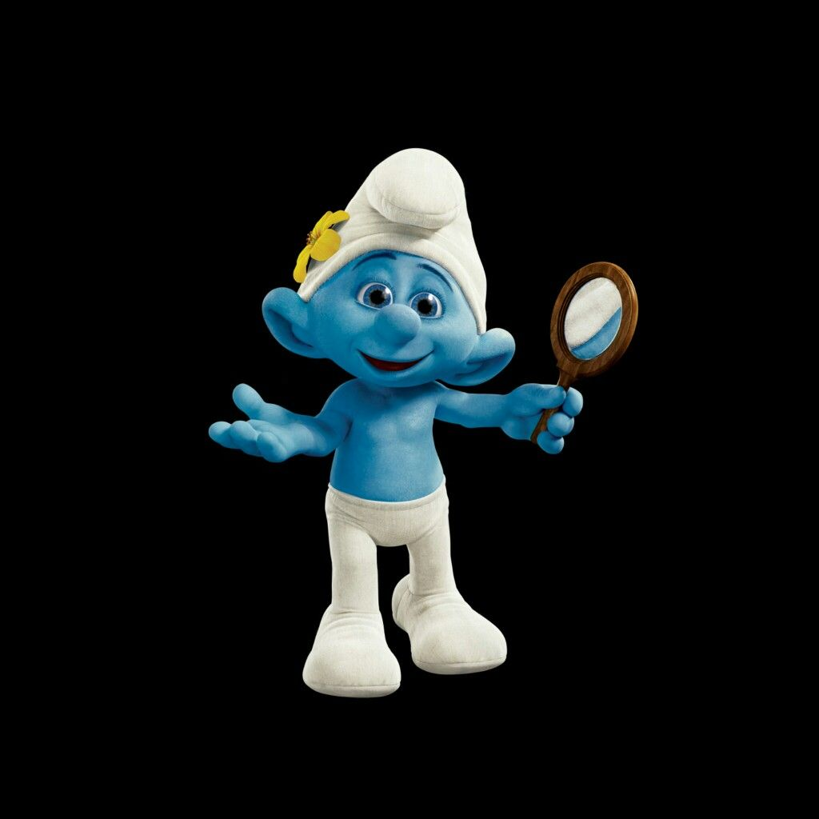
What are the benefits of translater?
Translation services provide the ability for two parties to communicate and exchange ideas from different countries. They can break down spoken word or translate documents to ensure that both parties understand each other in every

Slide 6

What is importance of translator?
Translation builds bridges between cultures. It allows you to experience cultural phenomena that would otherwise be too foreign and remote to grasp through your own cultural lens

Slide 7
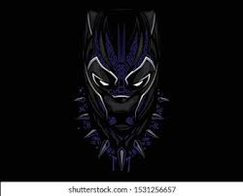
Toon-translator
It converts an ordinary English language to an fantasy character specified language and help us to understand an
how a Translator works on an customly created language

Slide 8
APPLICATIONS
Can be used to store confidential data
Convert data into secure form
To understand customisable fictional language
#BROCODE
A fun language experience

Slide 9
Team members
Sahil Anant Borse .
Arpita Kailas Pawar .
Rohan Anton Noronha .
Ganesh Devendra Mali .
Ramchandra Potdar .

Slide 10


